Slide 1



Milford, DE
The National Community Survey™
2025 Results
Notes:
I am happy to be here to present a summary of the findings from the Milford National Community Survey
Before I begin, on behalf of myself and my Polco coworkers, I’d like to thank Lauren Swain, our primary contact throughout the survey development and implementation process. They provided thoughtful and detailed feedback throughout the project.
I would also like to acknowledge my colleague, Lily Vasquez, who was Milford’s NCS project manager for this year’s survey and did the bulk of the work for this important project.

Slide 2



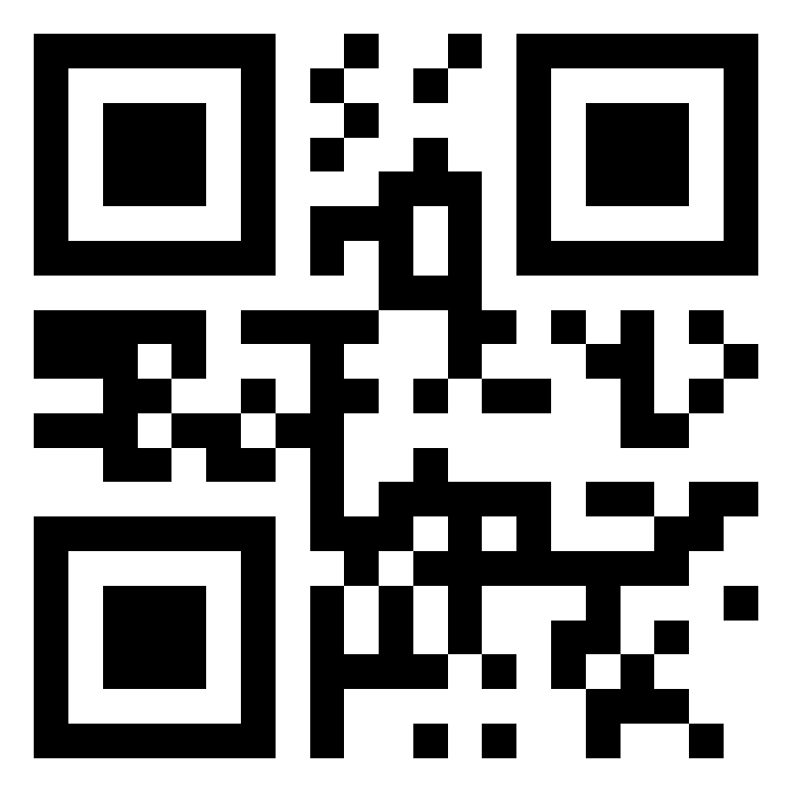



Civic Communication & Analytics Platform
Smarter, better-connected communities. A civic surveying, policy polling, and constituent communication tech platform.
Advanced Survey Science & Performance Analytics
Data insights to help communities move forward.
The premiere provider of professional civic surveys and performance benchmarking analyses.
Visit us online at
polco.us
Exclusive Partners
Notes:
Before we dive into your results, I’d like to share a little bit About Polco:
Polco is an online community engagement platform providing local governments with resident and employee feedback. Now, hundreds of organizations nationwide use Polco for strategic planning, budgeting, and empowering resident voices.
Polco merged with National Research Center in 2019.
About NRC:
NRC is best known for our national benchmarking surveys, such as The National Community Survey (The NCS), the National Employee Survey, and the Community Assessment Survey for Older Adults, among others. Since 1994, we've worked with hundreds of jurisdictions nationwide.
Our benchmark database is the largest of its kind in the United States.
Polco is also exclusive partners with:
International City/County Managers Association (ICMA)
The National League of Cities (NLC)
We also work closely with:
Engaged Local Government Leaders (ELGL)
Alliance for Innovation (AFI)
And many academic partners, including the American Association for Public Opinion Research, the University of Wisconsin-Madison, the Hoover Institute at Stanford University, and the Harvard Kennedy School of Government.

Slide 3




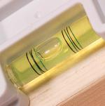
Resident Surveys in Local Governance
Monitor trends
in resident opinion
Measure government performance
Inform budget, land use, strategic planning decisions
Benchmark against other communities
Notes:
Before we dive into the results, I want to emphasize that there are a variety of ways these results can be used.
Most commonly, the jurisdictions we work with use their survey data to monitor trends in resident opinion over time and to inform budgeting processes and strategic plans. Our results also allow you to benchmark your community’s specific characteristics and services against communities in our benchmark database.
Our hope is that as these findings are presented, it will spur ideas for where you might want to dig deeper.

Slide 4

The NCS™ Facets of Community Livability
Economy
Mobility
Community Design
Utilities
Safety
Natural Environment
Parks & Recreation
Health and Wellness
Education, Arts, & Culture
Inclusivity & Engagement
Notes:
The National Community Survey, or The NCS, is a standardized five-page comprehensive survey that allows municipalities to assess resident opinion about their community and local government.
The NCS focuses on the “livability” of Milford by categorizing survey questions into 10 main “facets” of community livability as shown here.
These facets have been identified through extensive survey research as those that are most impactful to residents’ quality of life.
The NCS includes items within each of these ten facets, to provide a full picture of how residents feel about their community.
Finally, these facets also tend to align with municipal departments, making it easy for City staff to quickly find the information that is most important to them in the final report of results.

Slide 5

The National Community Survey™ in Milford
The NCS™ for Milford, DE
4th time conducting The NCS (previous surveys in 2022, 2019, 2017 )
Survey conducted from February 6th – March 20th
Mailing approach employed:
  Probability-based sample of 3000 randomly selected households
  361 total responses received
  12% overall response rate
  Non-probability, open-participation survey: 34 responses
Results statistically weighted to reflect Milford overall
95% confidence interval with a +/- 5.2% margin of error
Notes:
All households within Milford were eligible to participate in the survey. A list of all households within the zip codes serving Milford was purchased based on updated listings from the United States Postal Service. Using GIS boundary files provided by the City, addresses located outside of Milford boundaries were removed from the list of potential households to survey. From that list, 3000 addresses were randomly selected to receive the survey.
The 3000 randomly selected households received mailings beginning on February 6th, and the survey remained open for six weeks. The first mailing was a postcard inviting the household to participate in the survey. The next mailing contained a cover letter with instructions, the five-page survey questionnaire, and a postage-paid return envelope. Both the postcard and cover letter included a web link to give residents the opportunity to respond to the survey online. All follow-up mailings asked those who had not yet completed the survey to do so and those who had already done so to not respond twice.
Surveys translated into Spanish and Haitian Creole were made available to participants.
A total of 361 completed surveys were received from these efforts, providing a response rate of 12% and a margin of error of plus or minus 5.2 percentage points. We then compared the demographic profile of survey respondents to that of adults in Milford using the most recent Census and American Community Survey data and “weighted” the survey results. Weighting is a survey research best practice and helps to improve the representativeness of your survey results.
In addition to the randomly selected “probability sample” of households, a link to an online, community-wide “open participation” survey was publicized by Milford. The open participation survey was open to all city residents and became available on March 6th. The survey remained open for two weeks and 34 responses were received.
This presentation and the report are based on the 361 responses from the random sample, mail-based survey; the responses to the open-participation survey are provided separately in the full report.

Slide 6
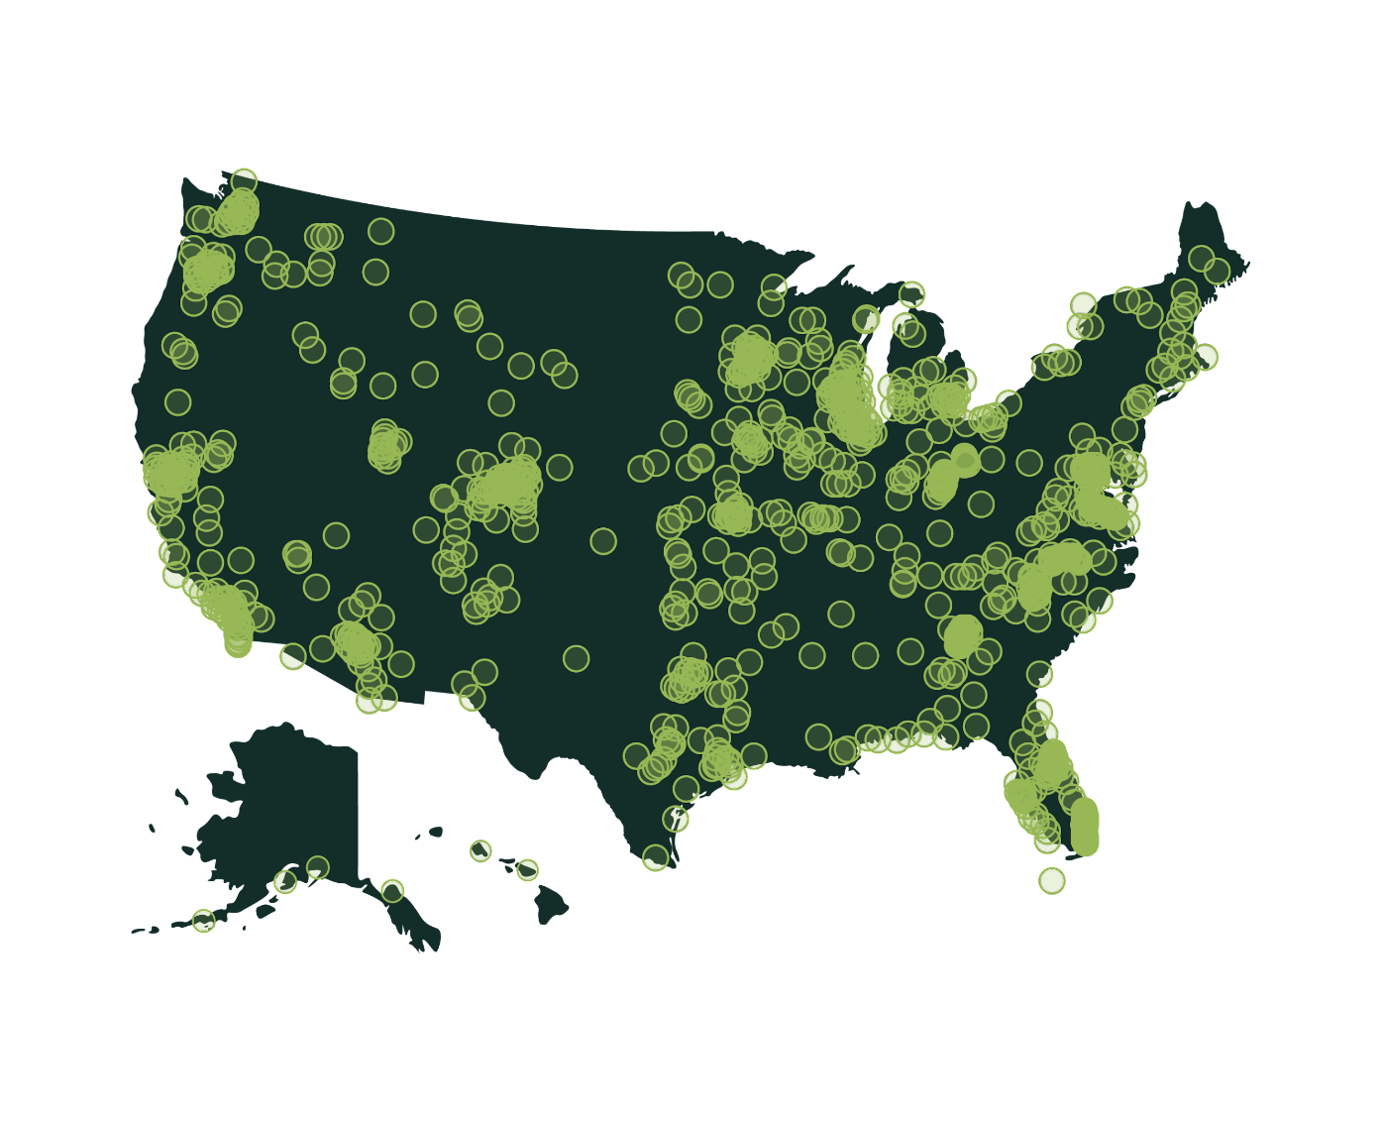
Polco’s Benchmarking Database
More than 500 comparison communities across the nation.
Representing the opinions of more than 50 million residents.
Notes:
One of the advantages to a local government of participating in our community surveys is the opportunity to compare ratings given by your residents to those from communities across the nation.
NRC was the first organization to conceive of the idea to create benchmarks of public opinion.
This allows jurisdictions to compare ratings of services to ratings of similar services from other communities.
There are currently about 500 communities in our database.

Slide 7



Overview of Survey Results

Slide 8
Facets of Community Livability: Quality
Percent excellent or good
Notes:
In the survey, we have two questions that ask directly about those 10 facets of community livability.
This first asks residents to rate the quality of each, and you can see the resulting comparison to the national benchmark in the shading on the chart.

Slide 9
Facets of Community Livability: Importance
Percent essential or very important
Notes:
The second question asks about the same facets of livability, but is centered on how important residents think it is for the community to focus on each facet in the coming two years.
So we ask about both the quality and importance of each of these facets, and we use those answers to create the quality/importance gap chart, which we’ll see on the next slide.

Slide 10
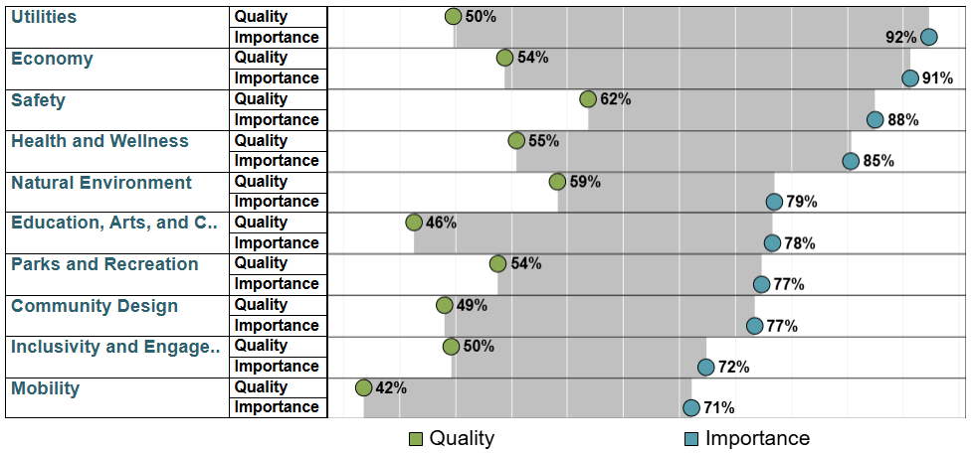
Balancing Quality and Importance
Notes:
We use this chart, which is also included in the report, to help determine which areas are of relatively higher importance and lower quality to residents.
This chart is one of many ways to interpret your data, and can be used to identify key findings and help a community determine which areas may need additional focus or resource allocation in the coming years, and which others are performing well by comparison.

Slide 11
Comparisons to National Benchmarks
0 received higher ratings
97 received similar ratings
26 received lower ratings
Notes:
Of the 123 survey items for which residents provided evaluative ratings, 0 received ratings higher than the national benchmark, 97 received similar ratings, and 26 received lower ratings.
Ratings are considered similar if they are within 10 points of the national average, and higher or lower if they are more than 10 points different from the average.
Top ranked (all similar to National Benchmarks)
Public library services (88%)
Safety in your neighborhood during the day (88%)
Safety in Milford's downtown/commercial area during the day (84%)
Fire services (83%)
Ambulance or emergency medical services (78%)
Lower (top 10 with lowest pctpos)
Milford open space
Public places where people want to spend time
Fitness opportunities
Drinking water
K-12 education
Ease of travel by bicycle
Recreational opportunities
Sidewalk maintenance
Affordable high-speed internet access
Adult educational opportunities

Slide 12
Comparisons to Previous Survey (2022)
7 received higher ratings
76 received similar ratings
40 received lower ratings
Notes:
When compared to results from Milford’s NCS results from 2022, in 2025, 7 received ratings that were statistically significantly higher than the previous survey iteration, 76 received similar ratings, and 40 received lower ratings.
Increases
Community support for the arts (+11%)
From property crime (+10%)
Street lighting (+9%)
Overall economic health of Milford (+9%)
Public library services (+8%)
Variety of business and service establishments (+7%)
Opportunities to attend special events and festivals (+7%)
Decreases (top 10 with the greatest decrease)
Water resources (beaches, lakes, ponds, riverways, etc.) (-18%)
Preservation of natural areas (open space, farmlands, and greenbelts) (-17%)
Traffic flow on major streets (-16%)
Availability of affordable quality childcare/preschool (-16%)
Availability of paths and walking trails (-15%)
Sidewalk maintenance (-15%)
Employment opportunities (-14%)
Yard waste pick-up (-14%)
K-12 education (-13%)
Milford open space (-13%)

Slide 13
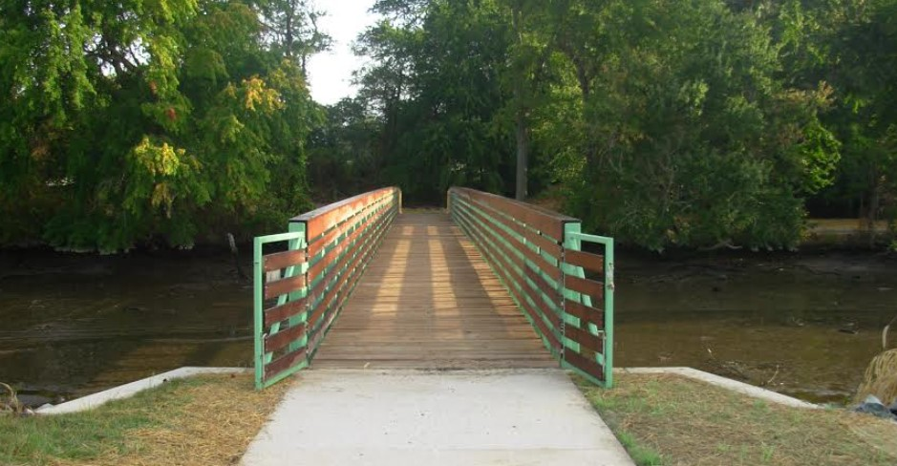
Key Findings
Notes:
Moving now into the highlights of our findings, I do want to point a few items that stood out to us as survey researchers.
There is a lot of additional data in the full report that we won’t cover today, but today’s presentation will focus on a few areas that we found to be most noteworthy within Milford’s survey results.

Slide 14

Milford’s quality of life ratings remain consistent with national trends.
1

Slide 15
Overall Community Quality
About 8 in 10 residents
Plan to remain in Milford for the next five years
Would recommend living in Milford to someone who asked
About
7 in 10
residents gave excellent or good ratings to:
Milford as a place to live
Notes:
About 7 in 10 residents rated Milford as a place to live positively, and two-thirds gave positive ratings to the overall quality of life.
In addition, roughly 8 in 10 residents planned to remain in the city for the next five years and said they would recommend living there.
All of these ratings were similar to the national benchmarks and remained relatively stable from the previous survey held in 2022.

Slide 16

Most residents feel a strong sense of safety in Milford.
2

Slide 17



Safety in Milford
Please rate how safe or unsafe you feel:
Percent very or somewhat safe
Notes:
More than half of residents rated the overall feeling of safety in Milford as good or excellent (62%).
Safety during the day in their neighborhoods (88%) and in the downtown/commercial area (84%) stand out.
Security regarding property crime has increased significantly since the last survey (63% to 73%).

Slide 18





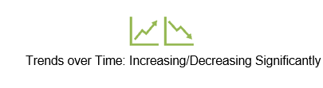
Safety Services in Milford
83%
78%
71%
57%
56%
Ambulance/
Emergency medical services
Emergency
preparedness
Animal
Control
Fire
services
Police/Sheriff services
Percent excellent or good
Notes:
Even with a few negative trends compared to the last survey, all services are rated similarly to the National Benchmark.
About 8 in 10 survey respondents positively rated fire services and ambulance/emergency medical services.
Police/Sheriffs services (71%) stayed consistent.
Animal control (56%) and Emergency preparedness (57%) are the aspects where there is more room for improvement.

Slide 19

Milford’s economic health is important to residents.
3

Slide 20
The Economy in Milford
Please rate each of the following in the Milford community:
Percent excellent or good
Notes:
Overall economic health is considered good or excellent by more than half of residents (54%), showing an improvement compared to previous surveys.
The overall quality of business and service establishments (62%) and variety of business and service establishments (50%) received positive ratings, with the latter items showing an upward trend.
Although employment opportunities displayed a declining trend from the previous iteration, it still remained on par with the benchmark.
Vibrancy of downtown/commercial area (42%), cost of living (41%), and shopping opportunities (36%) remain consistent.

Slide 21

Milford’s natural environment and parks and recreation opportunities show areas of opportunity.
4

Slide 22
Natural Environment in Milford
Please rate each of the following in the Milford community:
Percent excellent or good
Notes:
About two-thirds of community members positively rated cleanliness, recycling, air quality, and yard waste pick-up, the latter two items trending downwards from the previous iteration.
Water resources was rated positively from about half of residents.
Milford open space (42%) and preservation of natural areas (43%) saw a decline from the 2022 survey and scored below the benchmark.

Slide 23
Parks and Recreation in Milford
Please rate each of the following in the Milford community:
Percent excellent or good
Notes:
All items related to Parks and Recreation fell below the national average.
City parks received positive ratings from about half of survey respondents.
Availability of paths and walking trails (45%), recreation centers or facilities (44%), recreation programs or classes (42%), and fitness opportunities (40%) received less than favorable reviews.
Recreational opportunities (38%) although fell below the benchmark remained consistent.

Slide 24
Recreation Opportunities in Milford
Please rate how important, if at all, you think it is to add or expand the following city recreation opportunities in Milford.
Notes:
About 9 in 10 residents rated the following as essential or very important:
Parks and playgrounds (95%)
Bike trails and pedestrian paths (91%)
An indoor recreation center with sports, fitness, and youth programming (88%)
Hardcourt sports like basketball, tennis, and pickleball (87%)
Turf/softcourt sports such as soccer, baseball, softball, and beach volleyball (87%)
Around 8 in 10 residents said the following were essential or very important:
Swimming pool/splash pad (80%)
Amphitheater (79%)
Roughly 7 in 10 residents rated the following as essential or very important:
Skate park (73%)

Slide 25
Indoor Recreation Facility
How supportive, if at all, are you of the City of Milford constructing a new indoor recreation facility?
25
Notes:
About 8 in 10 community members felt very or somewhat supportive of the City constructing a new indoor recreation facility.
Very supportive: 49%
Somewhat supportive: 33%
Somewhat opposed: 11%
Very opposed: 7%

Slide 26

Mobility is an area of focus for the City.
6

Slide 27
Mobility in Milford
Please rate each of the following in the Milford community:
Percent excellent or good
Notes:
Ease of travel by car is the highest-rated category, with about 7 in 10 community members giving positive ratings.
Ease of public parking also saw positive ratings in about two-thirds of residents.
Ease of walking (52%) and traffic flow on major streets (51%) saw a decline from the previous iteration.
About 3 in 10 residents gave less than favorable ratings towards ease of travel by public transportation and ease of travel by bicycle, the latter item falling below other similar communities.

Slide 28





Mobility Services in Milford
63%
62%
60%
57%
57%
Street lighting
Traffic enforcement
Snow removal
Sidewalk
maintenance
Bus or transit services
Percent excellent or good
Notes:
Some mobility services stand out in Milford for their positive ratings like snow removal (60%), traffic enforcement (62%), and street lighting (63%), the latter item showing a statistically significant upward trend from the 2022 survey.
About 3 in 10 respondents gave less than favorable ratings towards bus or transit services and sidewalk maintenance. Both items also saw a decline, but sidewalk maintenance also fell below the national average indicating an area for improvement.

Slide 29
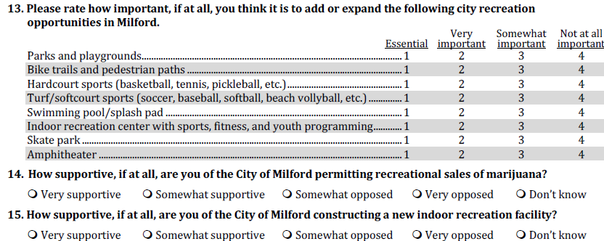
Additional Special Topics
3

Slide 30
Recreational Sales of Marijuana
How supportive, if at all, are you of the City of Milford permitting recreational sales of marijuana?
30
Notes:
About 6 in 10 residents felt very or somewhat positive of permitting the recreational sales of marijuana in the City of Milford.
Very supportive: 39%
Somewhat supportive: 18%
Somewhat opposed: 9%
Very opposed: 34%

Slide 31

Summary of Conclusions
Milford’s quality of life ratings remain consistent with national trends.
Most residents feel a strong sense of safety in Milford.
Milford’s economic health is important to residents.
Milford’s natural environment and parks and recreation opportunities show areas of opportunity.
Mobility is an area of focus for the City.

Slide 32

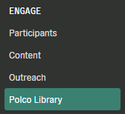
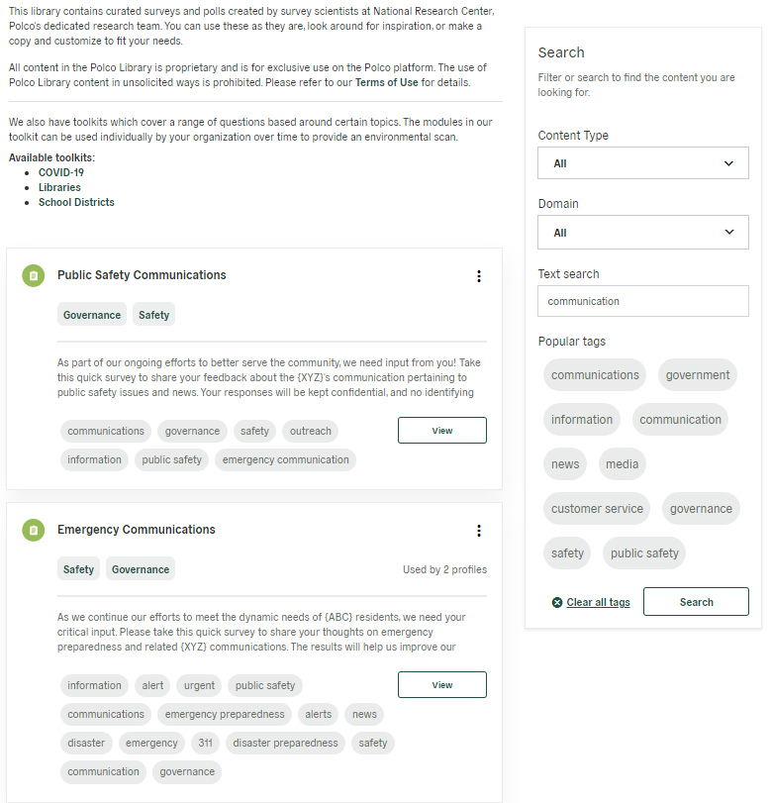


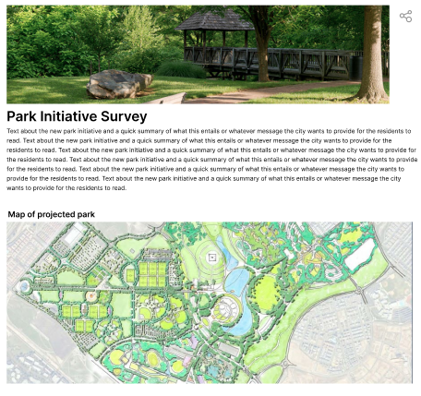


Next Steps: ENGAGE With Community Members
Customizable surveys and polls created by survey scientists at Polco.
Milford
currently has
197
subscribers on Polco.
Included in Current Subscription
Optional Add-on
Notes:
If you wish to dig deeper to find out more about the opinions and perceptions of residents, you can continue to engage with your community on Polco.
Milford currently has 197 residents who have subscribed to your Polco profile – you have an opportunity to create a consistent dialogue with these community members!
Polco’s Engage module is included as a part of your current subscription. Engage includes various resident feedback tools, including customizable polls, surveys, and live events.
Questions within these tools can include maps, images, videos or links to better inform respondents.
The Polco library is also included as part of the Engage module and contains curated surveys and polls created by survey scientists at Polco.
You can use these as they are, look around for inspiration, or make a copy of a survey and customize it to fit your needs.
Alternatively, if you have a survey or poll in mind, you can create one from scratch and reach out to your subscribers for feedback.
You do not have to do this all on your own: the Engage module provides you with access to a dedicated Customer Success Manager and Survey Researcher who are here to help you along the way!

Slide 33
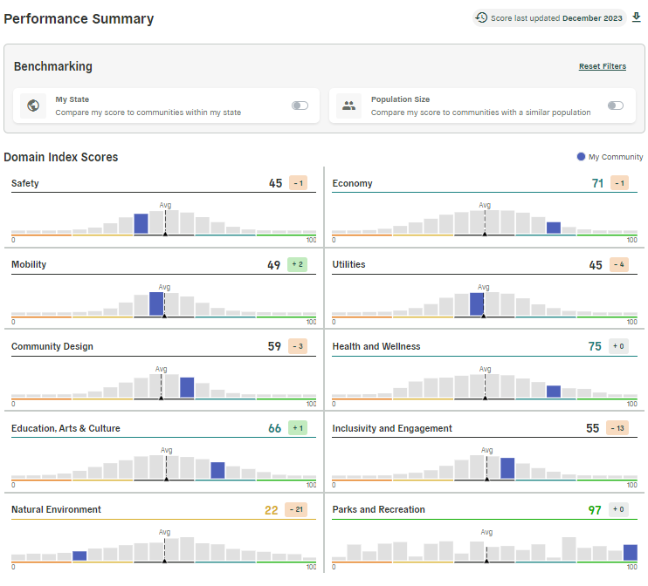
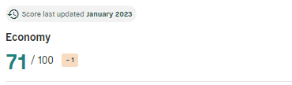
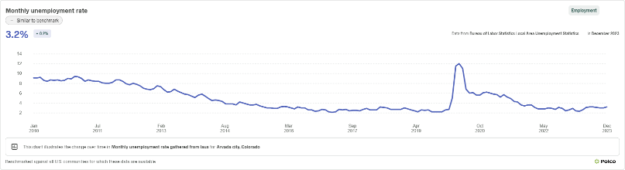
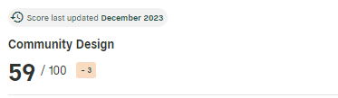
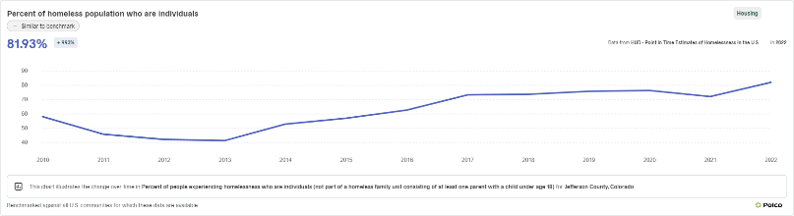
Next Steps: TRACK ABC’s Data
Included in Current Subscription
Optional Add-on
Notes:
*Data from Demo City*
Polco’s Track module is also included in your current subscription.
The Track Overview Dashboard, shown on the left, provides a big-picture look at your community data.
It includes key metrics, measures of performance over time, and compares ABC to peer communities within your state and within specific populations parameters
The dashboard is backed by academic, public, and private data in partnership with ICMA, NLC, Stanford University, Arizona State University, and the University of Wisconsin-Madison
In addition to the Overview Dashboard, individual dashboards for each of the 10 facets of livability are available for purchase
These Domain Dashboards provide a deep dive into a single facet and include dozens of publicly available datapoints that are tracked over time, benchmarked against other communities, and automatically updated for you
We track broad indicators like unemployment and crime rates, as well as very specific items like the percentage of children eligible for free or reduced lunch or the percentage of resident who live within a half mile of a public park
These Track offerings help communities best utilize a performance management system without the hassle of manual tracking or guesswork.

Slide 34


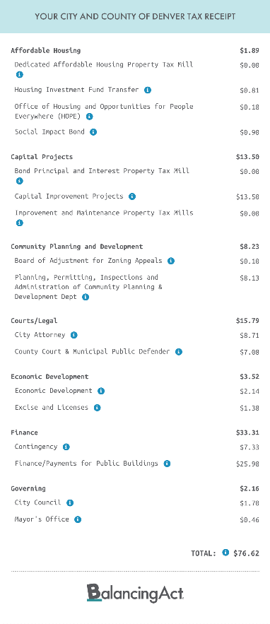
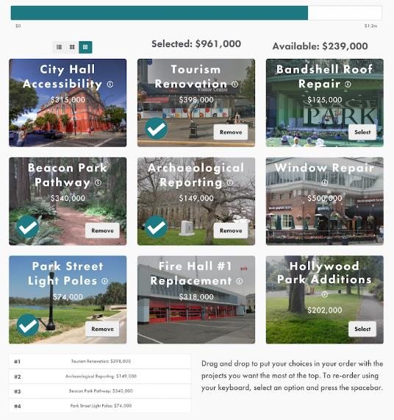


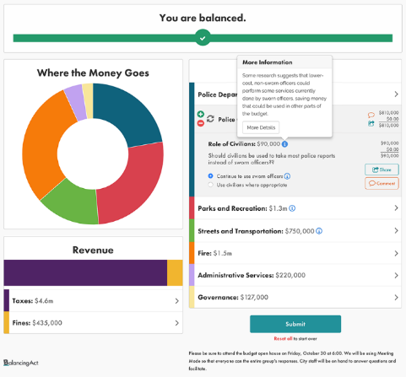



Additional Offerings: Continue to ASSESS
Included in Current Subscription
Optional Add-on
Notes:
Polco’s final module, Assess, includes benchmark surveys, like The NCS, which were developed by in-house data scientists and have been conducted in hundreds of jurisdictions nationwide over the past 25 years.
Each assessment targets a different subsection of your community, allowing you to focus efforts as needed.
Implementing different benchmark surveys can provide additional context for your data and give you a deeper understanding of your community's overall performance.
Benchmark assessments provide the most value when conducted regularly (at whatever cadence is right for you!) to refresh your results and see historical trends over time.
In 2023, Polco added Balancing Act and its suite of engagement tools to our Assess module, including Simulations, Taxpayer Receipt, and Prioritize.
Simulations allow residents to interact with a model of the City budget or housing plan and collects their input.
The taxpayer receipt lets users see an estimate of where the tax dollars went over the last fiscal year.
Prioritize is an engagement tool which allows residents to share their priorities on specific City projects
If interested, each of these Assess offerings can be added to your subscription.

Slide 35
Thank you!
Questions?
Brandon Barnett
Senior Survey Associate
Polco/National Research Center
brandon@polco.us

